Slide 1
De novo Transcriptome assembly & Annotation
Nizar Drou
Neelu Begum
18-19/March/2024

Slide 2
Expectations
Understand the concept of assembling RNAseq short reads.
Assemble a transcriptome using Trinity.
Be able to assess a de novo assembly using multiple methods.
Be able to annotate the assembly using Trinotate.
Be able to estimate Transcript expression levels and perform Differential Gene Expression analysis using the annotated assembly.
Visualize the assembly and the expressed transcripts.

Slide 3
Prerequisites
You will need an ACTIVE HPC account in order to participate in the workshop.
We are assuming the you are familiar with concept such as RNASeq, differential gene expression, alignment, and high throughput sequencing.
You have some basic UNIX command line knowledge.
You have some basic High Performance Computing knowledge.

Slide 4
Let’s submit some jobs
Head over to the Github page
https://github.com/nizardrou/De-novo-transcriptome-assembly-workshop
Follow the instruction to login to the HPC cluster, copy the data, and execute the qc.sh and the annotate.sh jobs.
“sbatch qc.sh”
“sbatch annotate.sh”
To monitor the status of your job, run “squeue”.
Once you have done that, let’s continue with the rest of the slides!

Slide 5
Basics of sequencing

Slide 6
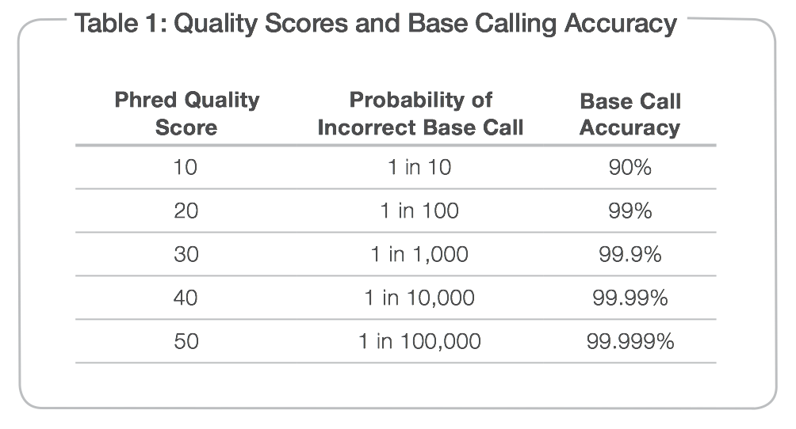
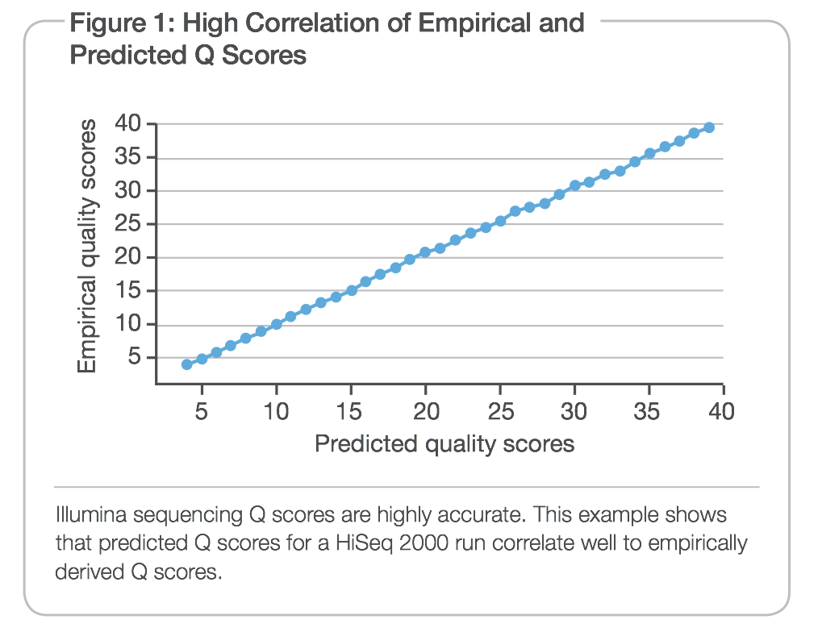
Illumina quality scores
Measured by Phred quality scores (Q scores).
Originally implemented for Sanger sequencing accuracy,
Peak resolution and shape
Confirmation of sequencing through large multivariate table lookups.
Highly accurate across chemistries and instruments
It is the standard quality metric for sequencing.
Process of generating and using lookup tables in Illumina is similar to the Sanger sequencing algorithm
www.illumina.com

Slide 7
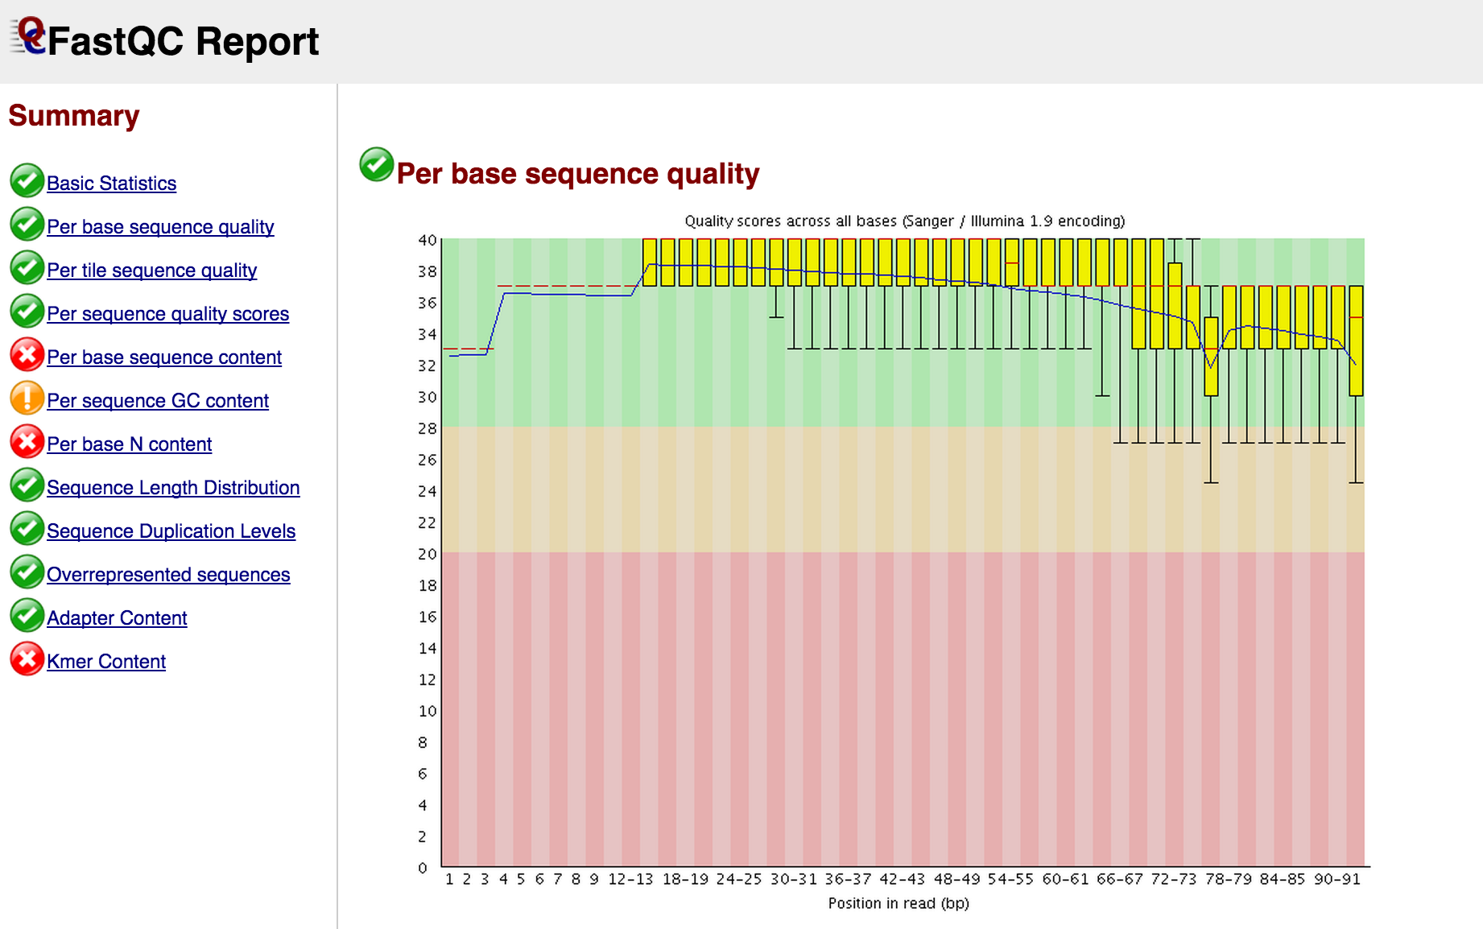
Primary analysis - QC

Slide 8
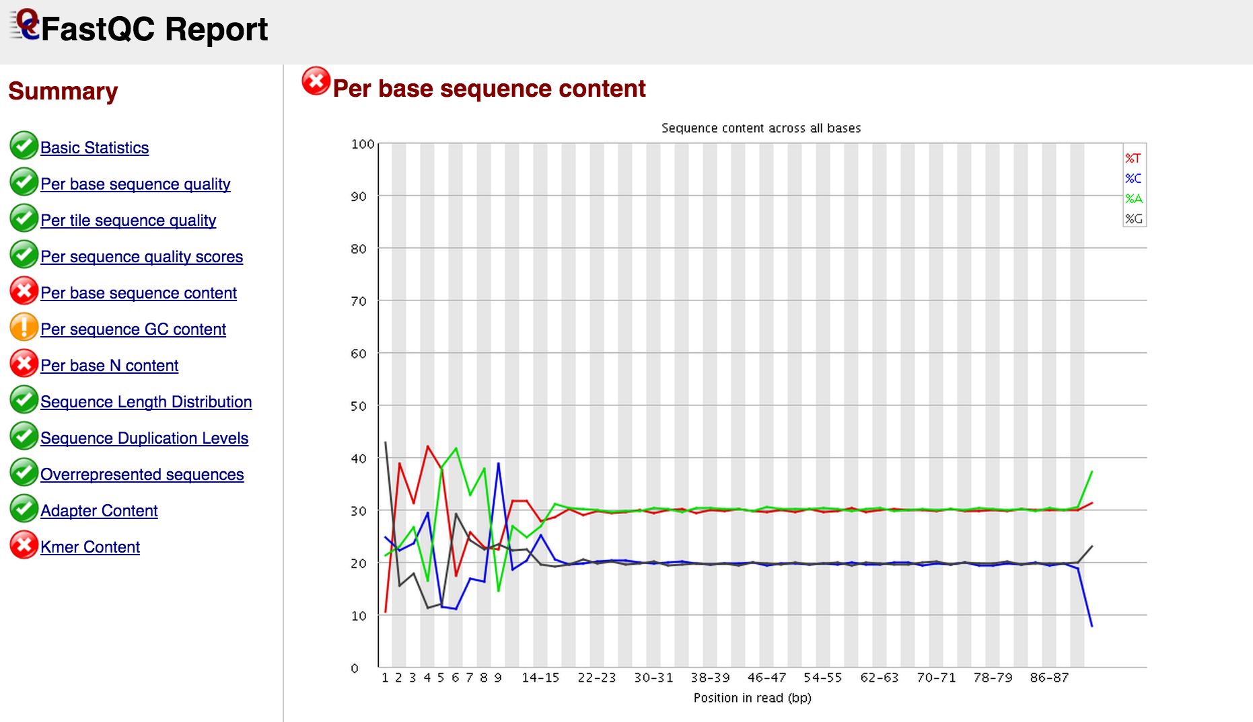
Primary analysis - QC

Slide 9
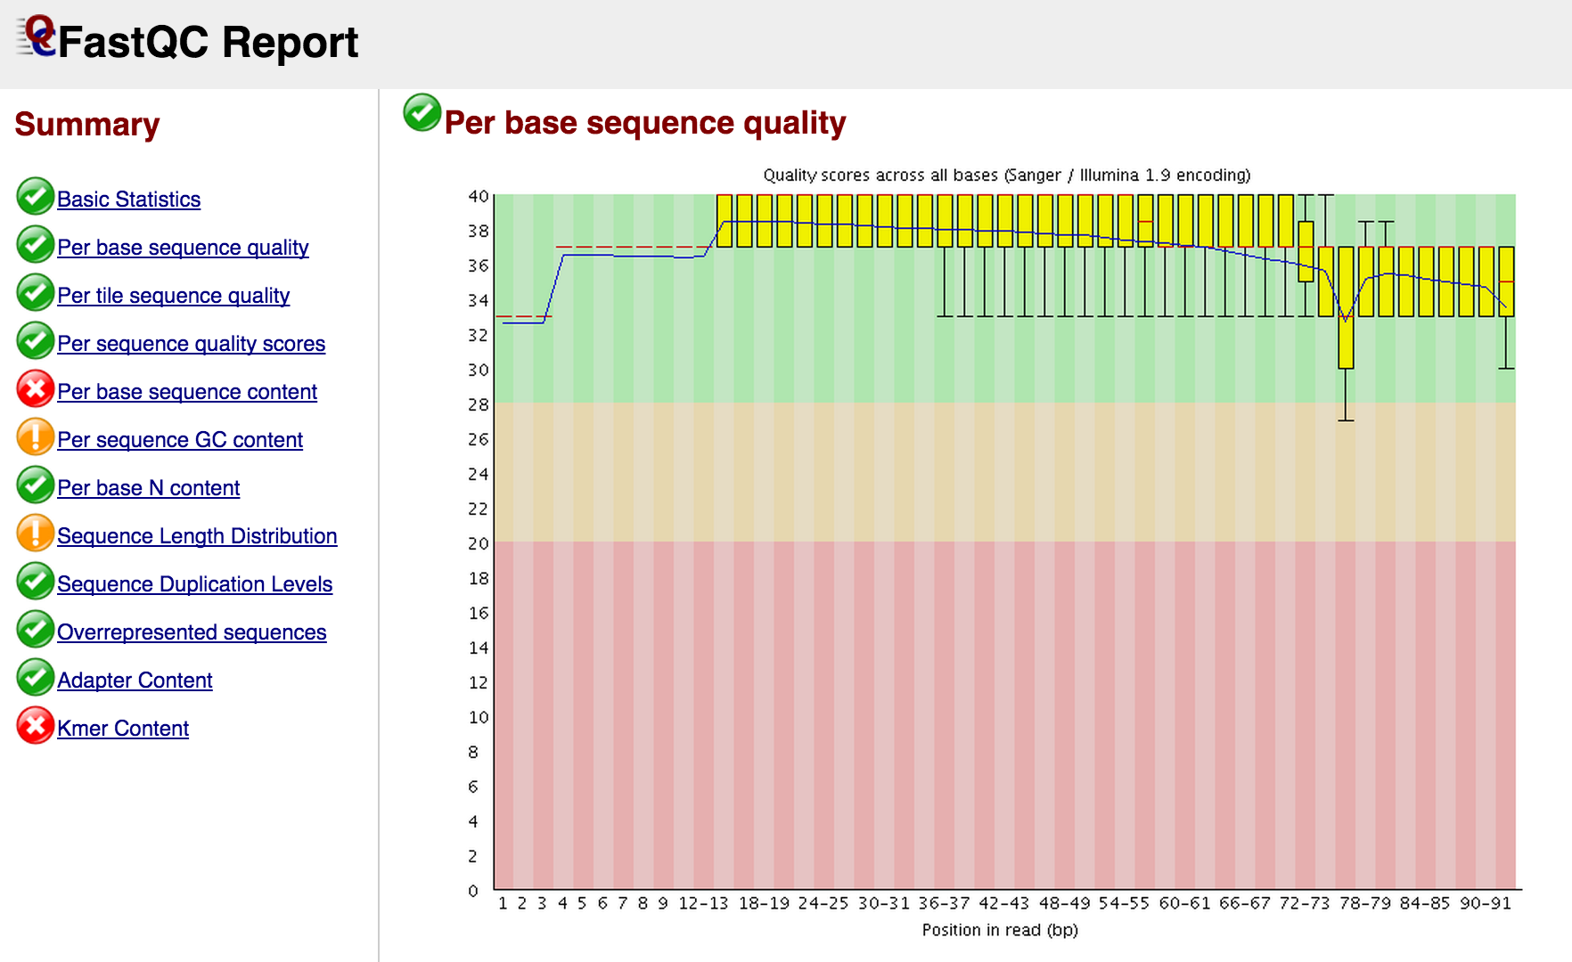
Primary analysis – quality trimming

Slide 10
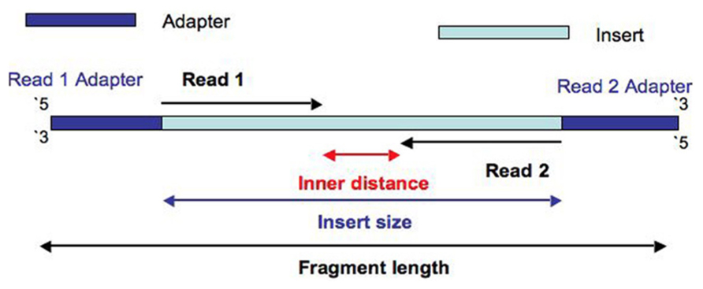
Sequencing adapter contamination

Slide 11
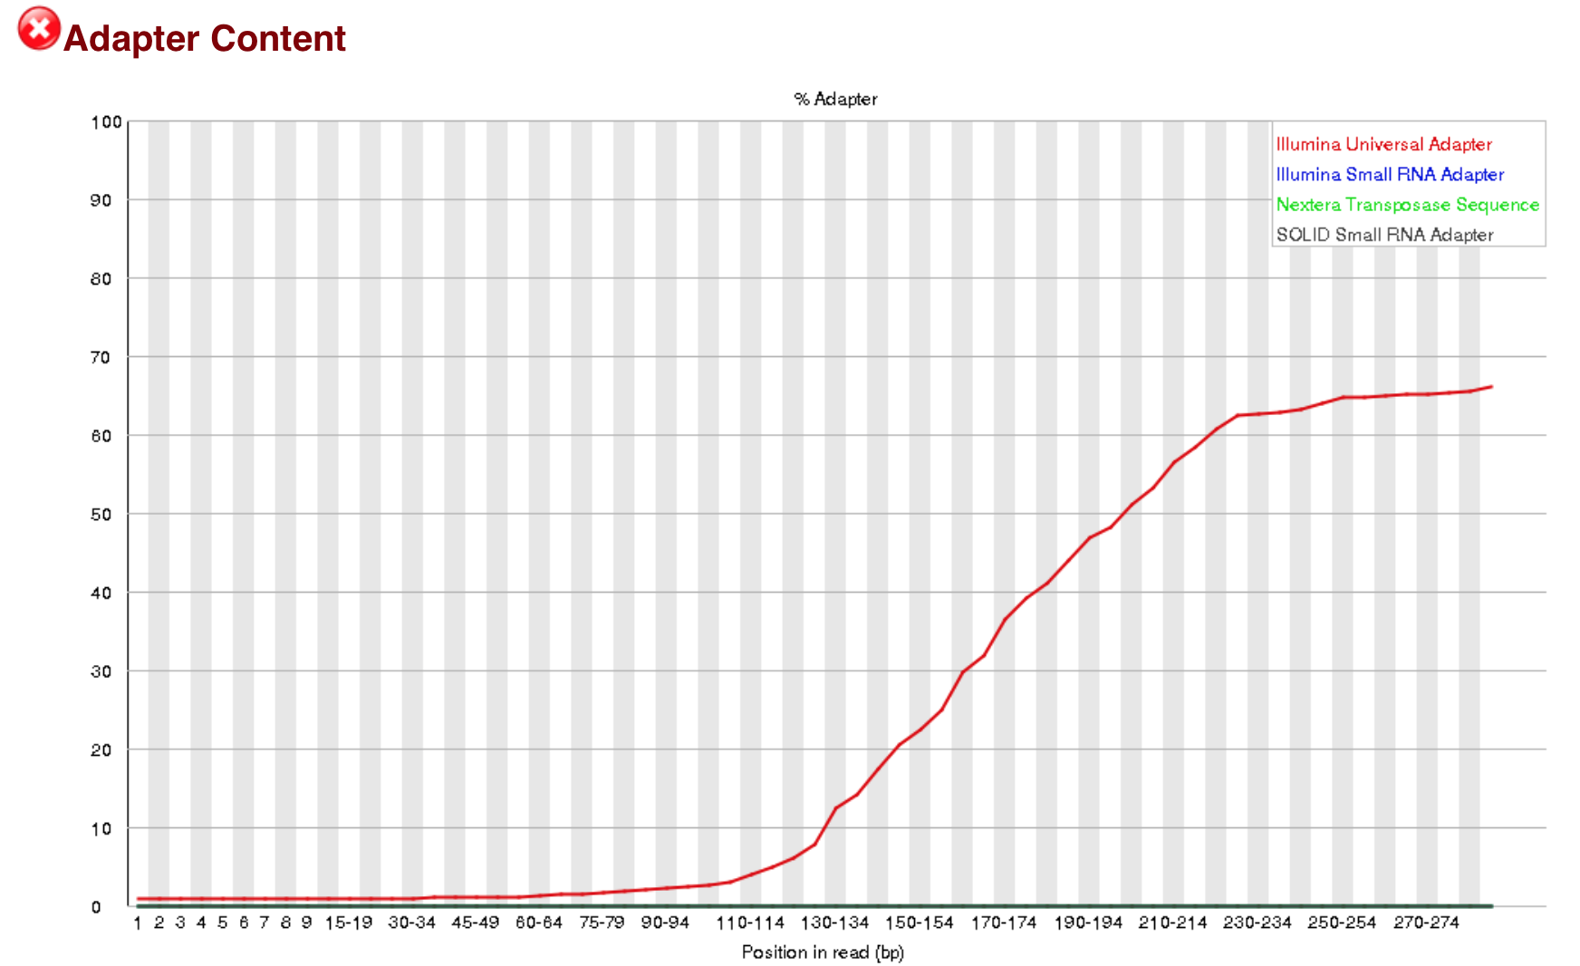
Sequencing Adapter contamination

Slide 12
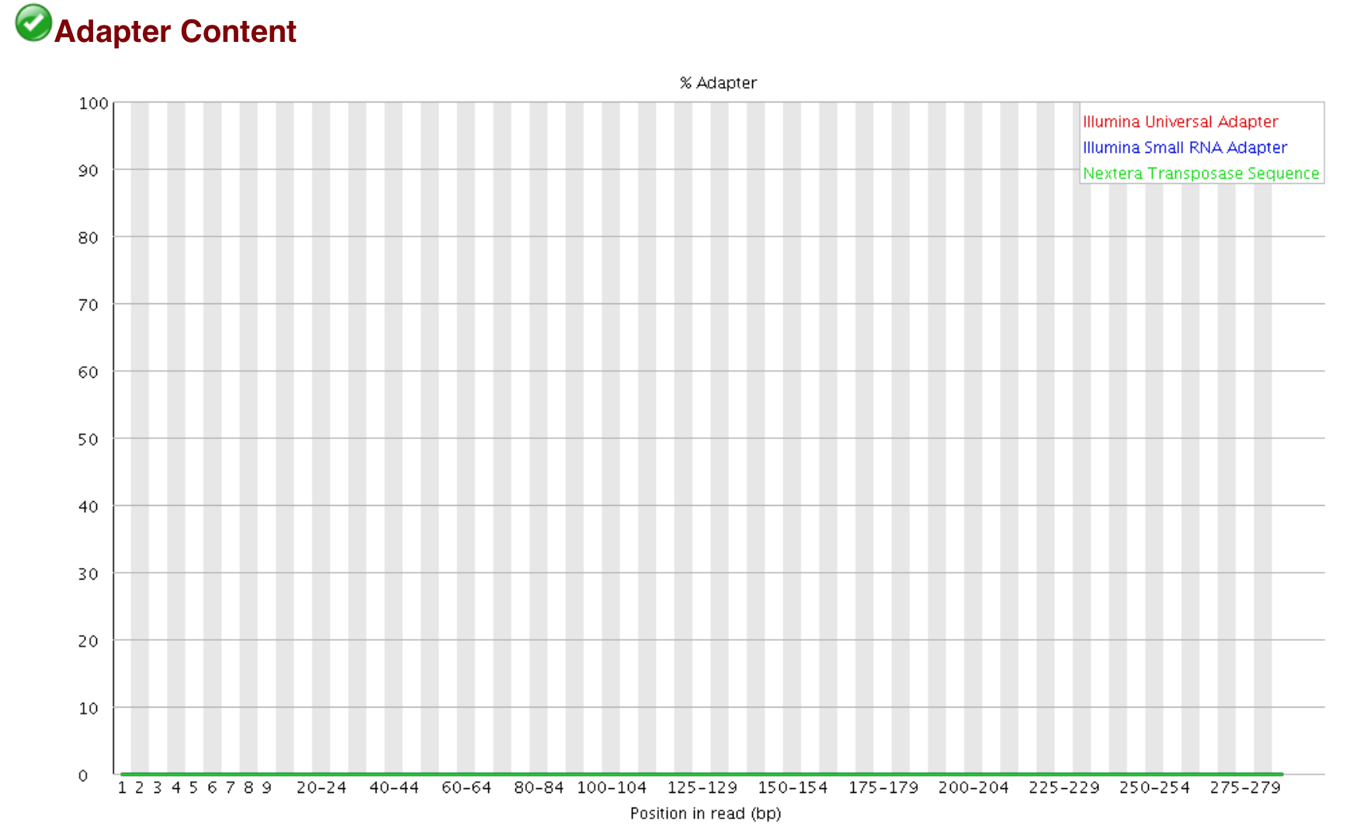
Sequencing adapter contamination

Slide 13
Sequence duplication levels
True biological duplication
RNA seq (i.e. gene expression)
Repeats
Amplicons
CHiPseq
Experimental
Optical – Result from 1 large cluster being identified as 2 separate clusters (they come from the same tile on the flowcell).
PCR – Can arise during the amplification of DNA for sequencing (more evident when starting material is small). The more PCR cycles, the more prominent they are.
Multiple tools available to remove and/or mark duplicates, but remember,
Did you use a PCR free protocol?
Do you expect duplication?
What sequencing instrument did you use?
What software is the sequencer using?
Post alignment de-duplication vs raw read de-duplication before alignment

Slide 14
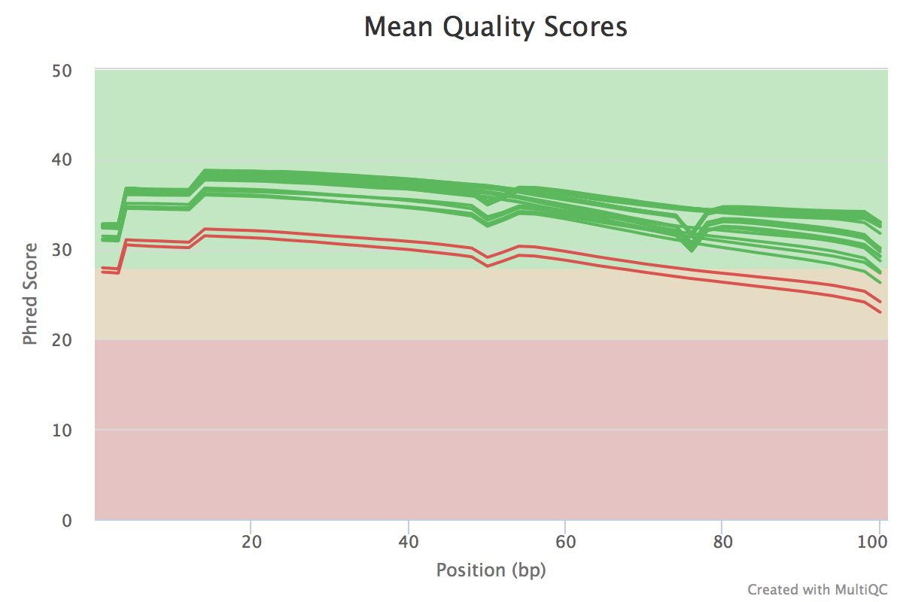
Other QC metrics
Systematic sequencing errors.
Barcode representation.
Raw sequencing output.
Pre and Post QT metrics,
Surviving reads
Surviving pairs
Quality profiles between read pairs
Read length distribution
Barcode representation
Duplication levels

Slide 15
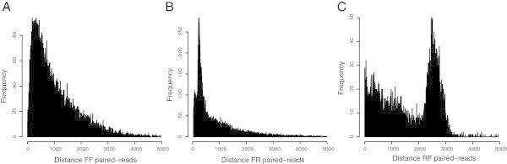
Insert sizes and paired data qc
Paired end reads – Pointing towards each other → ← & insert size 200bp-700bp.
Insert size distribution.
Orientation.
Mate pair reads – Pointing away from each other ← → & insert size 3kb-12kb.
Insert size distribution.
Orientation.
Proportion of Mates within contigs/scaffolds vs proportion across contigs/scaffolds.
QC and QT can affect mate pair libraries.

Slide 16
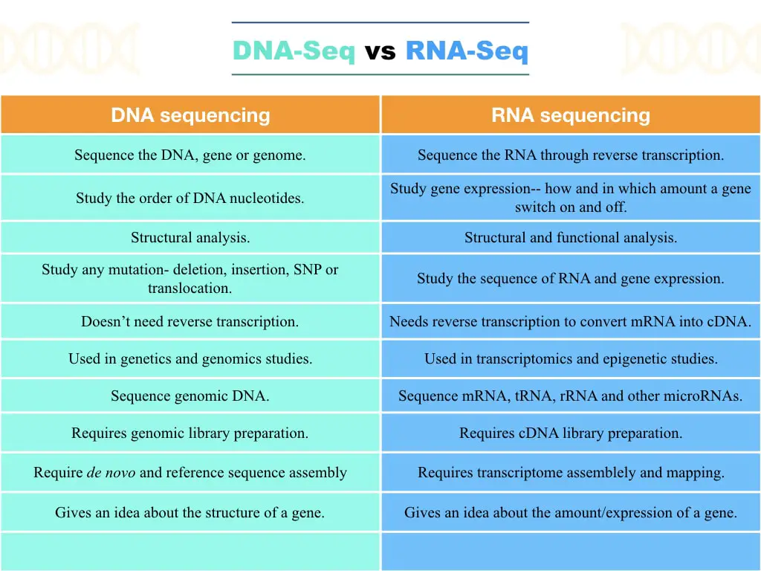
DNA vs RNA
https://geneticeducation.co.in/wp-content/uploads/2023/03/DNA-seq-vs-RNA-seq-2.001-min.jpeg

Slide 17
Common terms and definitions
K-mer (kmer) = A word of length k, or, all the possible substrings of a certain length that can be derived from a given string (or sequenced read).
String = ThisIsAnExample
K = 7
1st kmer = ThisIsA
2nd kmer = hisIsAn
3rd kmer = isIsAnE
Coverage = The “depth” of sequencing, i.e. how many times are we (likely) covering a given genomic region, based on the total amount of sequenced reads (and their length) vs the organism’s genome size.
Contigs = Are contiguous fragments that represent a genomic region, which have been assembled from sequenced reads.
Scaffolds = Result from ordering and “piecing together” assembled contigs. They include 2 or more contigs, and contain gaps (series of N characters), which represent the distance between ordered and oriented contigs.
N50 = A mathematical method for assessing the performance of an assembly. It is calculated using the lengths of assembled contigs/scaffolds. When contigs/scaffolds are ordered (shortest to longest), the N50, is the shortest sequence length at which at least 50% of all assembled bases contained. It says nothing as to the validity of the assembly.

Slide 18
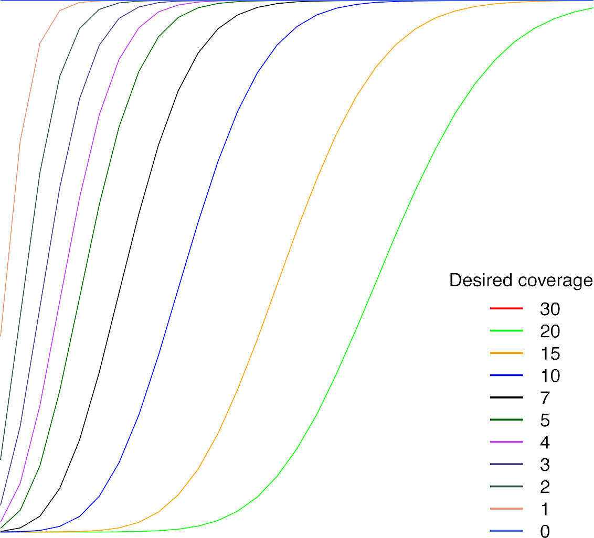
Coverage estimation

Slide 19
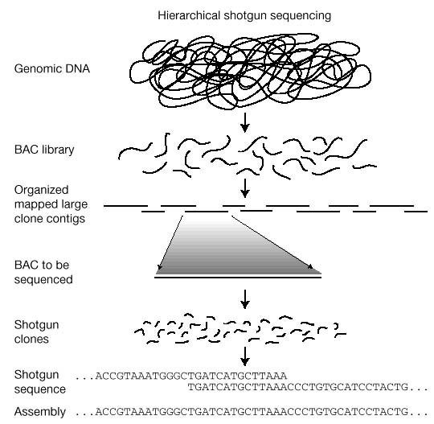
De novo assembly - overview

Slide 20
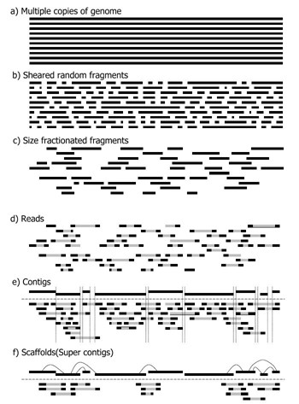
De novo assembly - overview

Slide 21
Read error correction
Makes more sense within a “de novo assembly” context rather than mapping.
Works at the kmer level, rather than the whole read (alignment) level.
In a de novo context, we are not looking for variation compared to a reference.
Examining read kmers of sufficient coverage can enable error correction.
Multiple tools available and some assemblers already incorporate read error correction before assembling.
Can reduce computational resource requirements during the assembly stage.
Improves resulting assemblies.
Some tools use multiple alignments at the read level rather than kmer multiplicities.
Understanding sequencing errors is key, hence most of the tools are geared towards Illumina data.

Slide 22
Digital normalization
The bigger the dataset size, the more resources and time we need! What can we do?
Digital normalization aims to remove redundant reads pre-assembly, thus reducing the computational burden.
At it core, digital normalization counts kmer profiles, and either accepts or rejects a read based on its kmer content.
Help remove sequence variants that further complicate the assembly and cause assembly breaks.
It can also help remove sequence errors that were missed during QC.

Slide 23
Kmer profiling
Kmer profiling can be very useful in assessing and validating assemblies as well as sequencing bias, levels of heterozygosity, and contamination.
For example,
Profile all Read1’s and Read2’s in a paired end sequenced library, and the assembly of the reads.
Compare Read1 profiles to Read2 profiles, there shouldn’t be any differences.
Compare the assembly profile to the reads, there shouldn’t be any unique profiles (kmers) in the assembly.
Compare Read1 and Read2, again profiles shouldn’t differ.
GC distribution of unique kmers can show up and possibly indicate contamination.

Slide 24
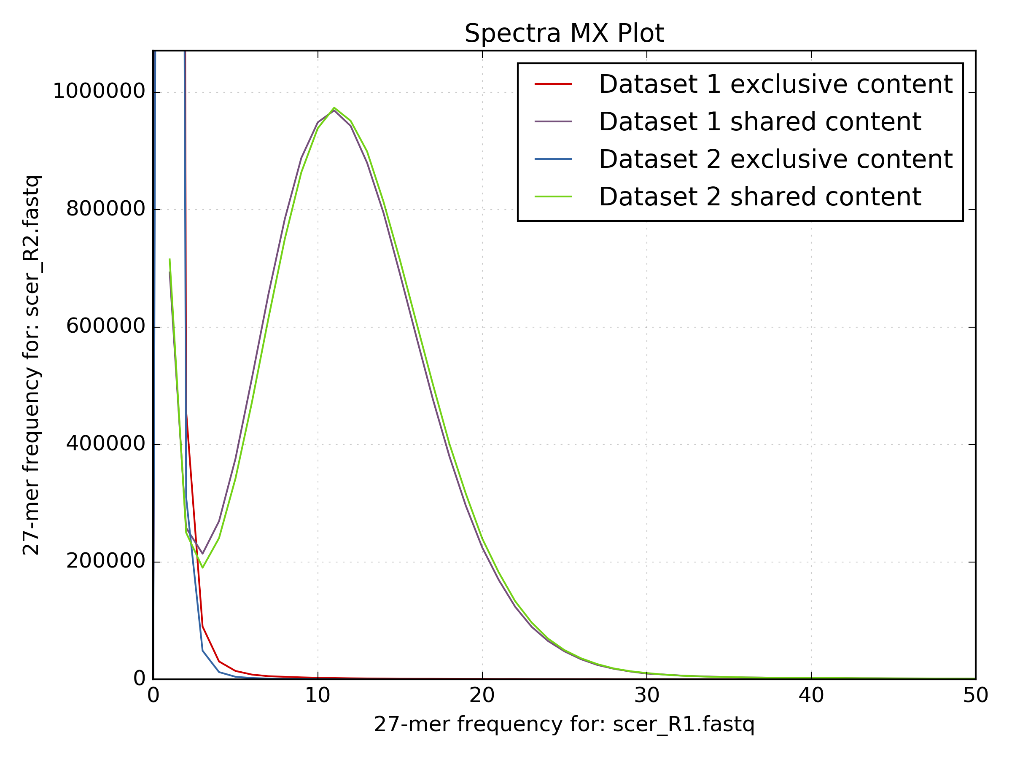
Kmer profiling

Slide 25
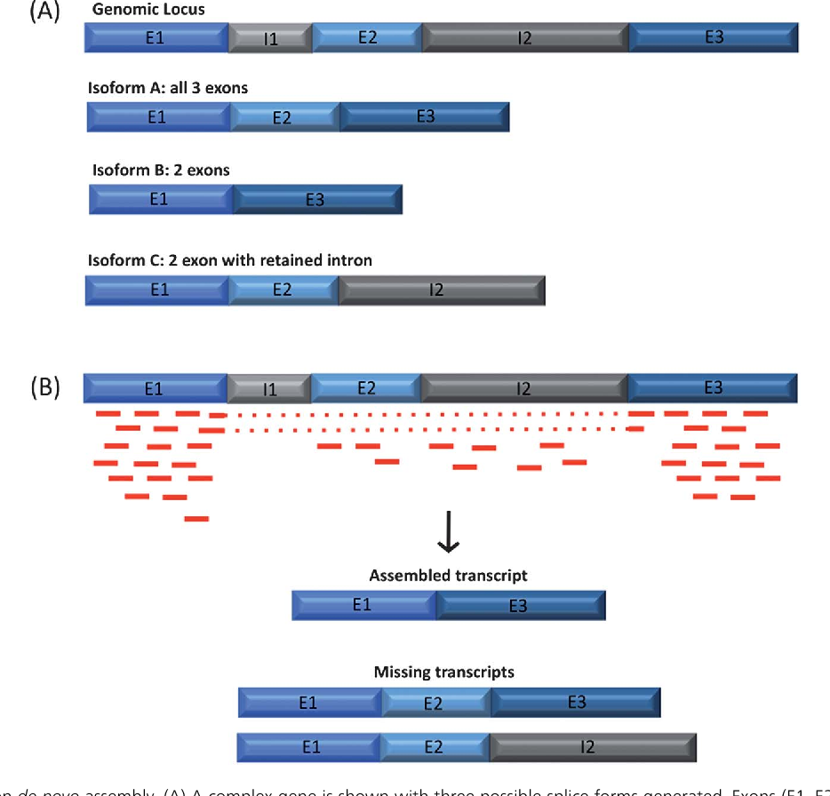
RNAseq coverage and expression
https://www.semanticscholar.org/paper/Bioinformatics-challenges-in-de-novo-transcriptome-G%C3%B3ngora-Castillo-Buell/7a1de972559129c501e1687d0b2912e752a89166/figure/4

Slide 26
Overlap layout consensus
Identify overlaps between reads (suffix of one read and prefix of another read).
Layout the reads based on their alignments.
Produce a consensus sequence based on read overlaps and contig merging.
E.g. 454 newbler, ARACHNE, PHRAP, CAP, TIGR, CELERA.
Can be very slow and computational requirements high as the size of the input data increases and genome size increases.

Slide 27
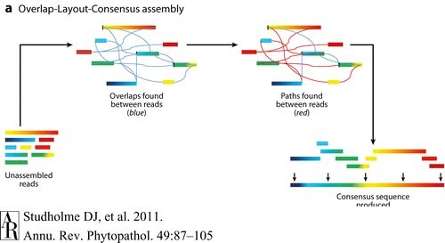
Overlap layout consensus
Notes:
Build the overlap graph
Bundle stretches of the overlap graph into contigs (layout)
Pick most likely nucleotide sequence for each contig (consensus)

Slide 28
assembly – de Bruijn graph assembly
Graph theory concept established ~300 years ago by mathematician Leonhard Euler to solve the bridges of Königsberg problem, and laying the foundation of graph theory (then known as geometry of position).
The challenge is to cross each of 7 bridges once and end up at the starting location.
Euler was able to propose a solution by representing land masses as “nodes” and bridges as “edges” within a graph.

Slide 29
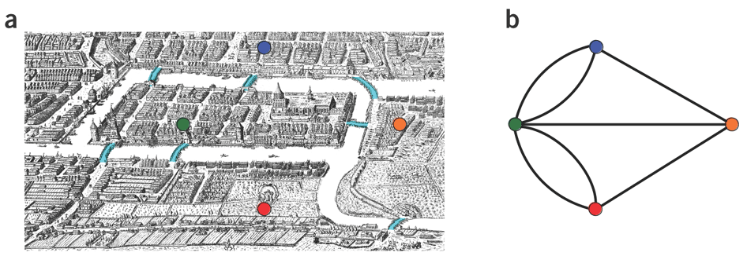
The 7 bridges

Slide 30
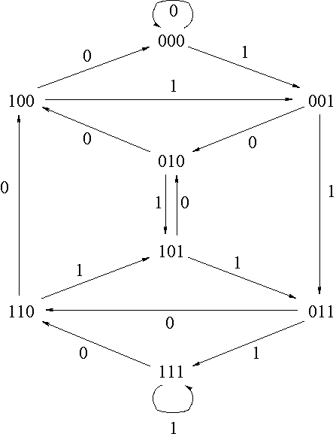
Genome assembly – de Bruijn graph assembly
K=3

Slide 31
De Bruijn Graphs
AACTAACGACGCGCATCAAAA

Slide 32
De Bruijn Graphs – K=7
AACTAAC GACGCGCATCAAAA
AACTAAC

Slide 33
De Bruijn Graphs – K=7
A ACTAACG ACGCGCATCAAAA
AACTAAC
ACTAACG

Slide 34
De Bruijn Graphs – K=7
AACTAACGACGCGCATCAAAA
AACTAAC
ACTAACG
CTAACGA
TAACGAC
AACGACG
ACGACGC
CGACGCG
GACGCGC
ACGCGCA
CGCGCAT
GCGCATC
CGCATCA
GCATCAA
CATCAAA
ATCAAAA

Slide 35
De Bruijn Graphs – K=7
AACTAACGAC G CGCATCAAAA ACTAACGAC T CGCATCAAAA
AACTAAC
ACTAACG
CTAACGA
TAACGAC
AACGACG
ACGACGC
CGACGCG
GACGCGC
ACGCGCA
CGCGCAT
GCGCATC
CGCATCA
AACGACT
TCGCATC
ACGACTC
CTCGCAT
GCATCAA
CGACTCG
GACTCGC
ACTCGCA
CATCAAA
ATCAAAA

Slide 36
De Bruijn Graphs – K=7
AACTAACGAC G CGCATCAAAA ACTAACGAC T CGCATCAAAA
AACTAAC
ACTAACG
CTAACGA
TAACGAC
AACGACG
ACGACGC
CGACGCG
GACGCGC
ACGCGCA
CGCGCAT
GCGCATC
1x
2x
2x
2x
CGCATCA
AACGACT
TCGCATC
2x
ACGACTC
CTCGCAT
GCATCAA
CGACTCG
GACTCGC
ACTCGCA
CATCAAA
2x
ATCAAAA
2x

Slide 37
De Bruijn Graphs – K=7
CAACAAA
CAACAAA
GCAACAA
AACTAACGAC G CGCA T CAAAA ACTAACGAC T CGCA T CAAAA ACTAACGAC G CGCA A CAAAA
CGCAACA
1x
GCGCAAC
2x
2x
2x
2x
2x
CGCGCAA
1x
AACTAAC
ACTAACG
CTAACGA
TAACGAC
AACGACG
ACGACGC
CGACGCG
GACGCGC
ACGCGCA
CGCGCAT
GCGCATC
1x
3x
3x
3x
CGCATCA
AACGACT
TCGCATC
2x
ACGACTC
CTCGCAT
GCATCAA
CGACTCG
GACTCGC
ACTCGCA
CATCAAA
2x
ATCAAAA
2x

Slide 38
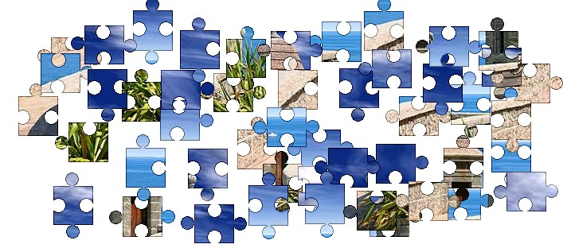

repeats
A1
A1
A2
A3
>90%
DNA
A2

Slide 39
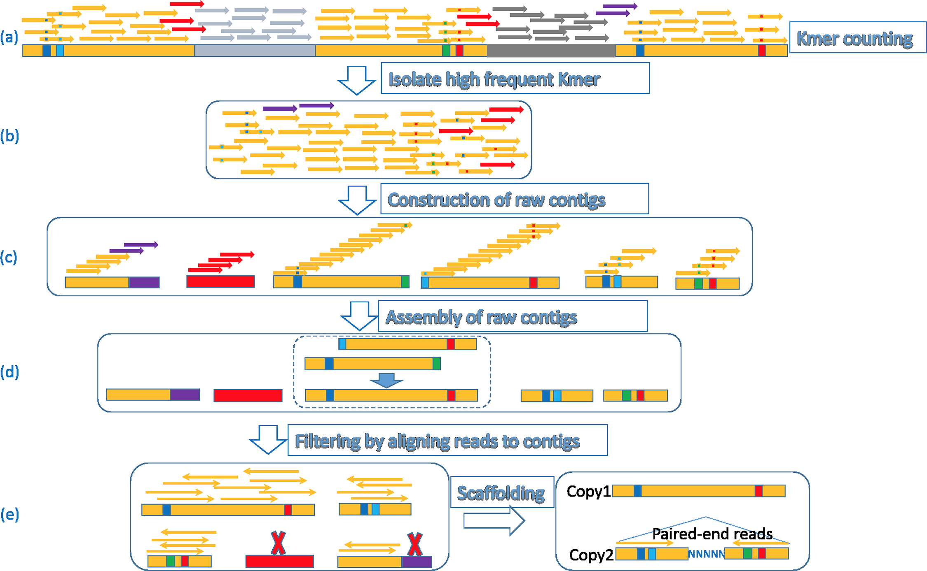
Why are repeats problematic?
Difficult to characterize.
Repeat size cannot be spanned.
They can represent a large portion
of the genome (25%-40% of most mammalian genomes).
Repeats are important so assembling
them is useful (e.g. disease).
Dedicated software to
characterize repeats can help,
for example,
RepeatMasker
REPdenovo/RepARK
REPdenovo: Chong Chu et al PLOS ONE, 2016

Slide 40
contamination
When aligning to a reference, screening the “unmapped” reads is a sensible approach, what about de novo genomes?
Closely related reference can be used, but won’t be accurate.
Care must be taken when de-contaminating de novo reads.
Example,
Bacteria A is sequenced.
Standard contamination screen (Human, Mouse, E coli, PhiX) revealed 12% of reads are E coli.
Removed the contaminated reads.
Assembled the de-contaminated (clean) reads, as well as the “raw” reads.
The unfiltered (raw) reads assembly outperformed the filtered assembly. Why?
That 12% “contamination” are actually reads that map to both, E coli and Bacteria A!
PhiX contamination screening is relatively easy.
Remove/screen with some common sense.
Tip: Collapsing your reads and characterizing them (BLAST) can also help.

Slide 41
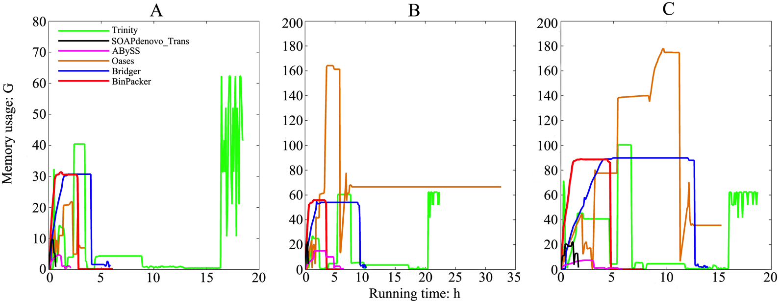
Considerations – computational resources
Input data size and type of input data.
Memory.
CPUs.
Walltime.
Storage.
Performance of a specific software given the genome to be assembled.

Slide 42
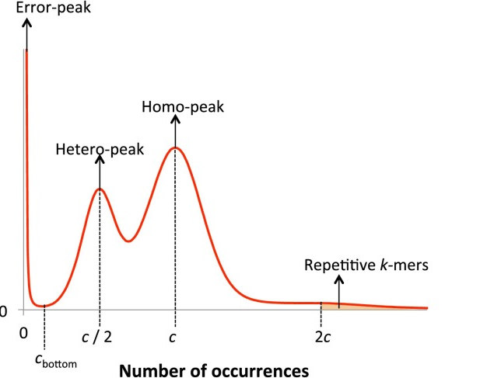
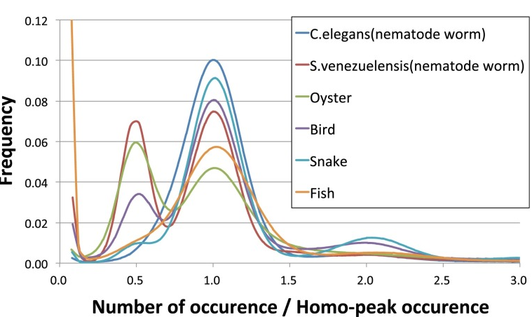
Considerations – heterozygosity

Slide 43
Assembly “gold standards”
http://assemblathon.org/
An “offshoot” of the Genome 10K project, primarily organized by UC Davis Genome Center.
Contests to determine and assess state-of-the-art methods in the field of genome assembly.
Groups have to use their own methods/software to assemble, assess, and validate real or simulated datasets, within a given timeframe and with a set of rules.
There are different categories in the contests.
A paper is published at the end of an “Assemblathon” with results and guidelines.
Branch out to encompass all levels of assembly approaches, such as metagenomics and RNA-seq.
Organize workshops.
The de Novo Genome Assessment Project (dnGASP) is a similar European effort.
The Genome Assembly Gold-standard Evaluations (GAGE), is yet another ‘in-house’ project aimed at evaluating the performance of assemblers and methods.

Slide 44
De novo assembly considerations - recap
Computational resources.
Genome size.
Repeat content.
Ploidy, heterozylgosity.
Closely related reference(s).
Cost (sequencing libraries, sequencing output).
Sequencing platforms.
De novo transcriptome sequencing.
Availability of starting material (Optical/Restriction mapping?)
Manual finishing (BAC libraries, PCR across gaps etc.).

Slide 45
RNAseq de novo considerations
Variable coverage due to expression.
Not all genes are always actively transcribed.
On/Off genes.
Tissues and replicates and conditions.
Experimental design.

Slide 46
What we will do
Assemble using Trinity (pre-computed).
Assess the assembly quality (Alignment, N50, BUSCO, QUAST).
Annotate using Trinotate with homology based searching.
Quantify expression (RSEM).
Perform DGE analysis using DESeq2.

